Slide 1
Configuring and Customizing Letters in Alma
Yoel Kortick
Senior Librarian
Sept. 2025

Slide 2
Agenda
Introduction
The "Letters Configuration" page
XSL, XML, Labels, and Letter Examples
  The XSL Editor
  Collapsing Sections, Indentation and Auto Complete
  The XML Editor
  Labels
Drafts for letters in the XSL Editor
Components Configuration
Drafts for components in the XSL Editor

Slide 3
Introduction

Slide 4
Introduction
This presentation will cover the entire process for configuring and customizing letters.
As we will see the letter configuration functionality provides an intuitive and easy-to-use method, the most prevalent of which is the WYSIWYG (What You See is What You Get) feature when configuring the XSL.

Slide 5
The "Letters Configuration" page

Slide 6

The "Letters Configuration" page
All Alma letters can be accessed for configuration via the Letters Configuration page
This page is accessed via "Configuration > General > Letters > Letters Configuration"

Slide 7
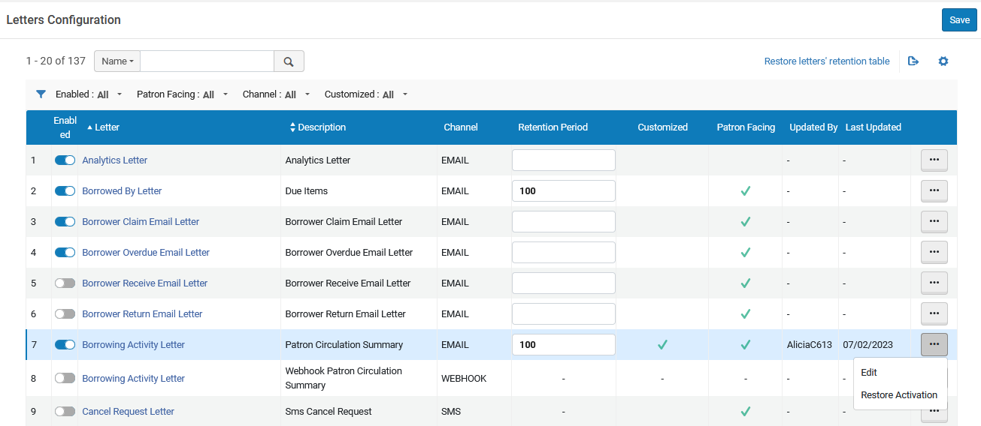
The "Letters Configuration" page
The Letters Configuration Page
Set letter retention
Enable / Disable a letter
Access the Labels, Template and Letter Examples for the specific letter

Slide 8
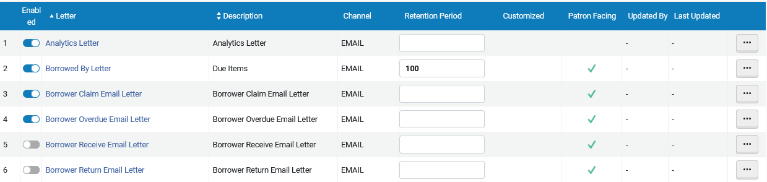
The "Letters Configuration" page (enabling a letter)
If a letter is enabled then it will print (be sent), and if it is disabled then it will not print (be sent)

Slide 9
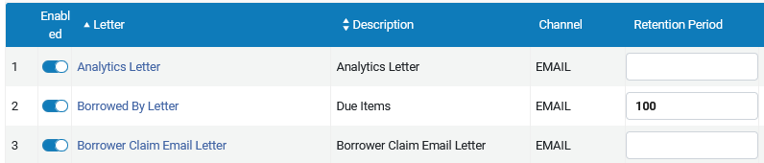
The "Letters Configuration" page (retention period)
The retention period determines how long the letter will remain in the attachments tab of the patron
If there is no retention period, then the letters will remain in the attachments tab indefinitely.

Slide 10
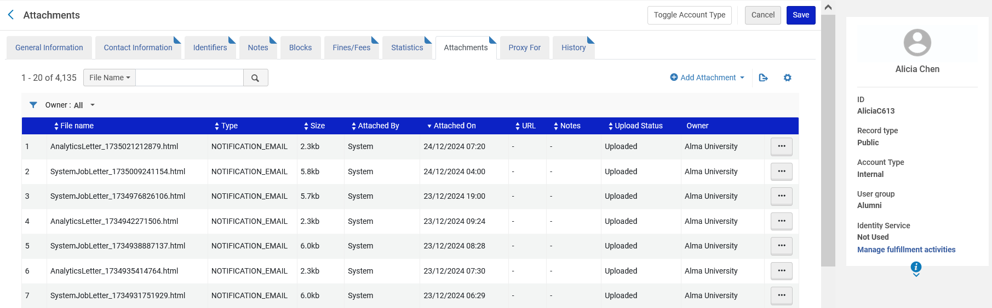
The "Letters Configuration" page (retention period)
If these letters have a retention period, then then they will be removed from this list when older (in days) than the retention period

Slide 11
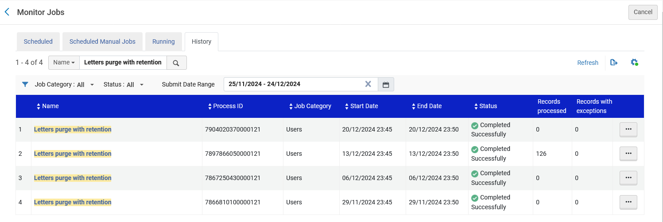
The "Letters Configuration" page (retention period)
The letters are purged (removed) when the weekly scheduled job "Letters purge with retention" runs

Slide 12
XSL, XML, Labels, and Letter Examples

Slide 13
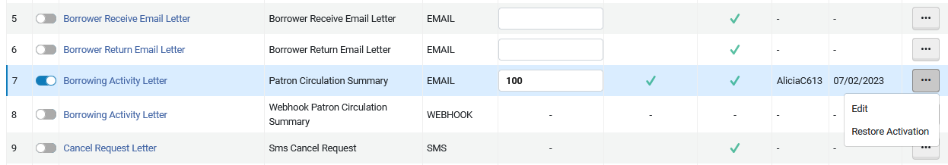
XSL, XML, Labels, and Letter Examples
When a staff user selects "edit" from the "Letters Configuration" page he or she will arrive to the page of XSL, XML, Labels, and Letter Examples for the specific letter

Slide 14
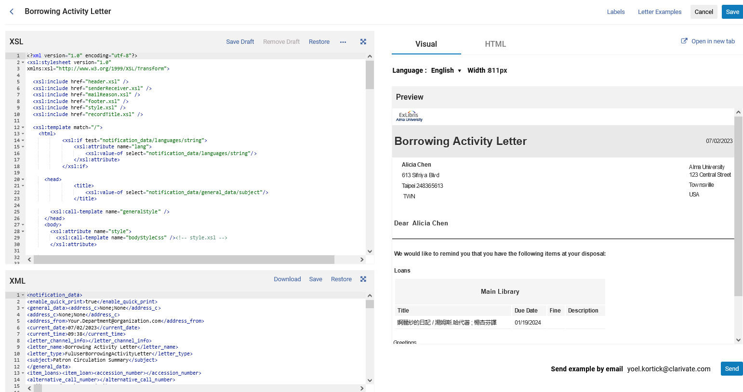
XSL, XML, Labels, and Letter Examples

Slide 15
The XSL Editor

Slide 16
The XSL Editor
The XSL determines the appearance of the letter. For example, if text will be bold, in a particular font, left, right or center justified, in a table or in text, etc.
When the user edits the XSL the Preview pane is updated according to the changes in the XSL.
This is the case even before saving the XSL.
This allows users to see what the changes would look like in a letter without yet saving the changes.

Slide 17
The XSL Editor
The XSL Editor

Slide 18
The XSL Editor
After editing the XSL users may
  Save the changes
  Restore the XSL to its original state (the default version supplied with Alma)
  Save the changes as a draft to continue editing later
Additionally, users may
  View the XSL in full screen mode
  Contribute the XSL to the community
  View other XSL versions contributed by other institutions in the community and if desired copy them to their own institution.

Slide 19
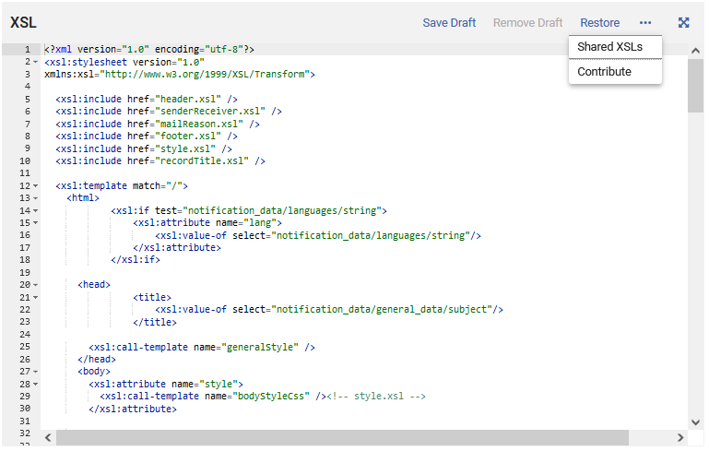
The XSL Editor
View in full screen mode
Restore the XSL to its original state
Save as a draft
Remove Draft
Contribute the XSL to the community
View and potentially copy other versions of the XSL which have been contributed by other institutions
Edit the XSL here

Slide 20
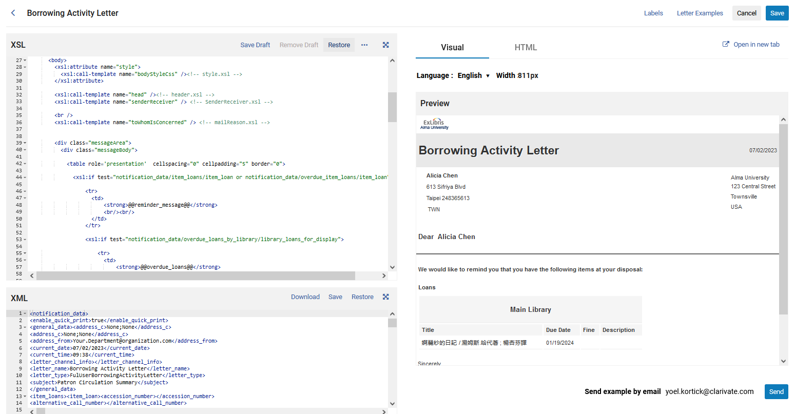
The XSL Editor
We will now edit the reminder message (font color and size) and be able to see the change immediately before saving the letter

Slide 21
The XSL Editor
As an example, we will change this
<tr>
<td>
<strong>@@reminder_message@@</strong>
<br/><br/>
</td>
</tr>
To this
<tr>
<td>
<font color = "red" size = "5"><strong>@@reminder_message@@</strong></font>
<br/><br/>
</td>
</tr>

Slide 22
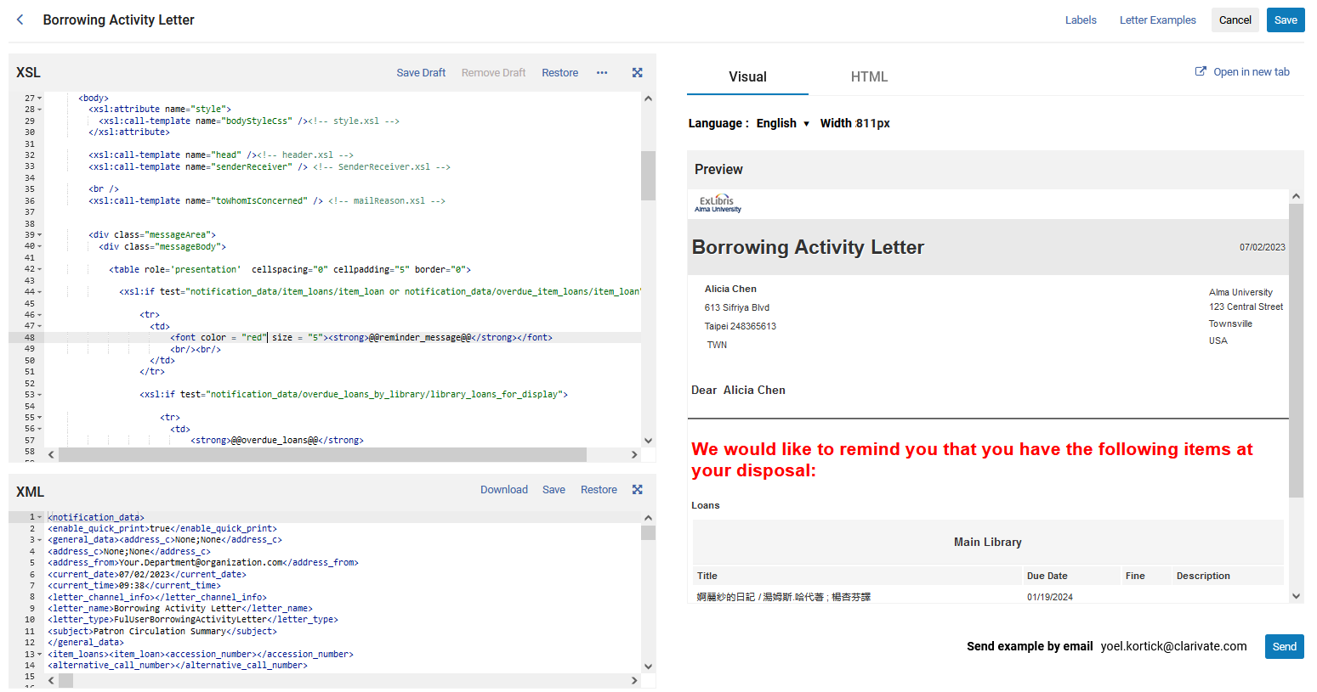
The XSL Editor
We changed the XSL here
We immediately see the change in the preview here

Slide 23
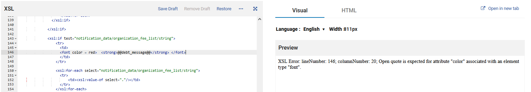
The XSL Editor
Note that when editing the XSL, if the user makes a mistake, then Alma will not only state that there is an error but also state what it is and where it is.
Here for example the staff user editing the XSL forgot to put quotes around the font color. Alma states what the error is and exactly where it is.

Slide 24
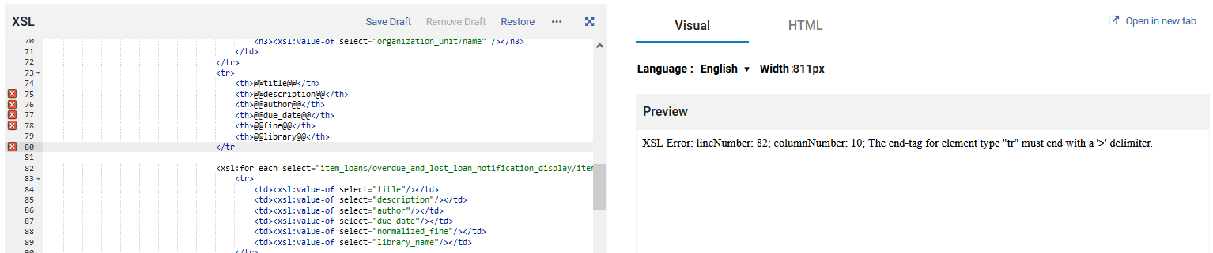
The XSL Editor
Here for example the staff user editing the XSL forgot to close the <tr> with a ">". Alma states what the error is and exactly where it is.

Slide 25
The XSL Editor
We can save the changes as a draft to continue working on later (more on that later in a dedicated section of the presentation)
We can save the changes

Slide 26
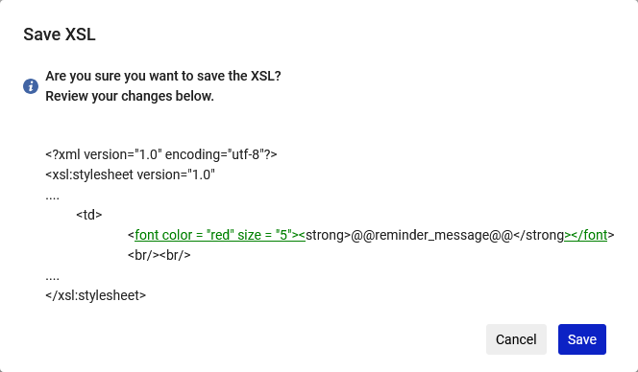
The XSL Editor
After clicking "Save" Alma will tell the user what the changes which have been made are:

Slide 27
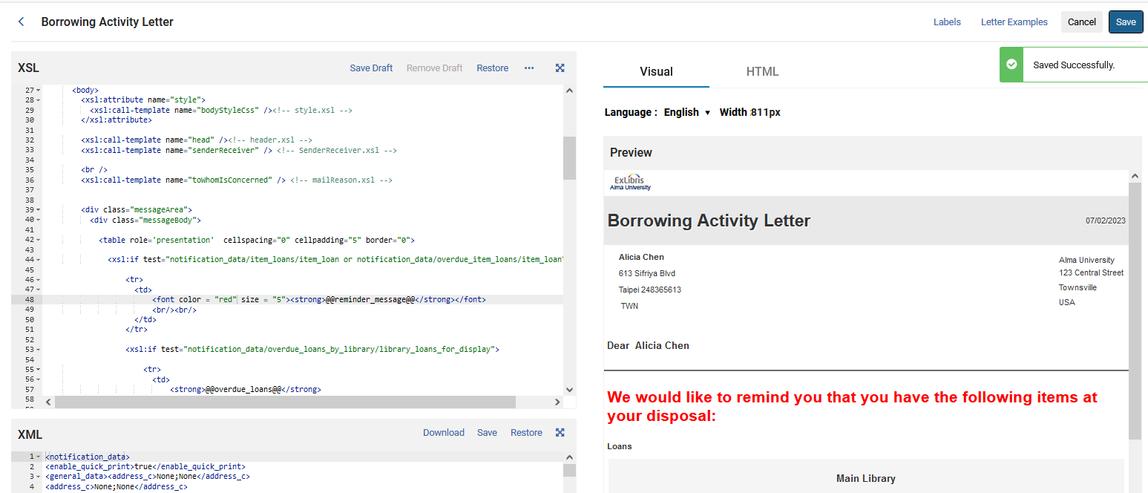
The XSL Editor
We have saved the changes and now this is the letter that will be used by Alma

Slide 28
The XSL Editor
While editing the XSL it is possible to send it via email.
In this way the staff user doing the editing will be able to see exactly how it would appear in an actual email.

Slide 29
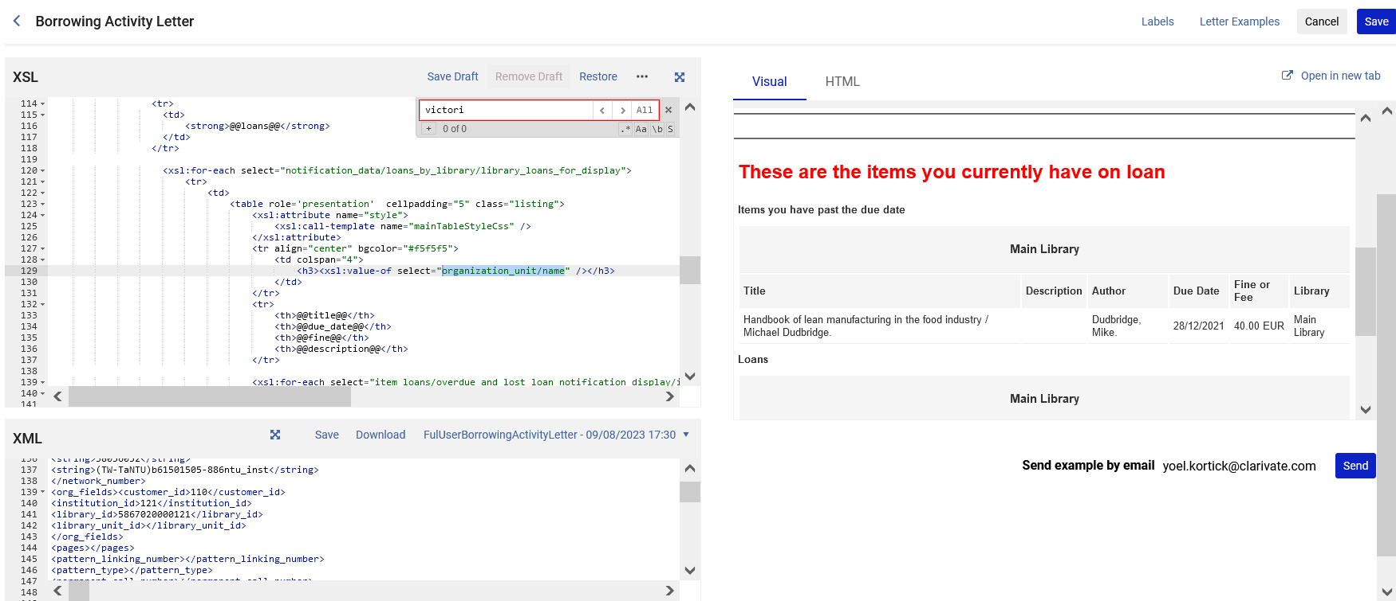
The XSL Editor
Click here to send the letter via email. It will by default go to the email of the logged in user.

Slide 30
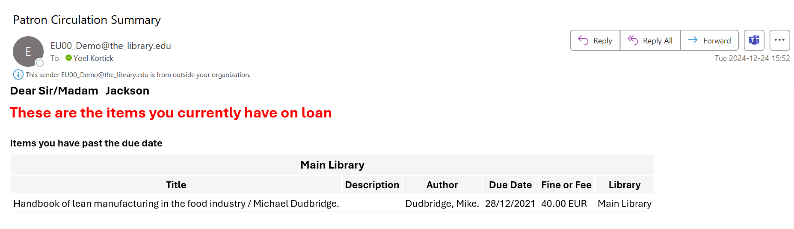
The XSL Editor
The letter gets sent to the specified email

Slide 31
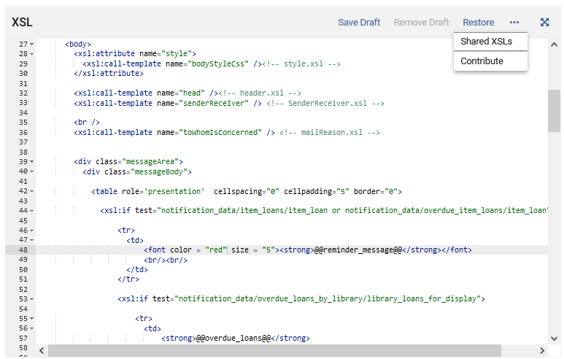
The XSL Editor
We can contribute the XSL to the Community

Slide 32
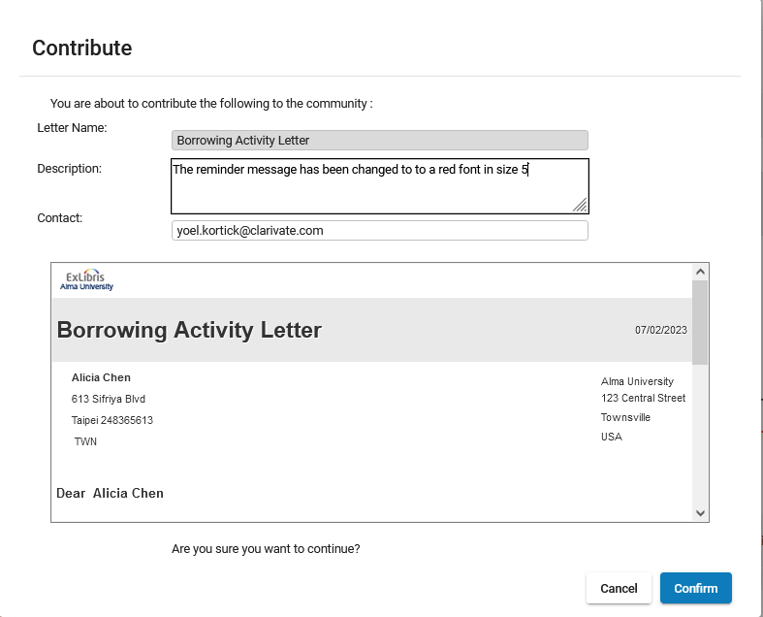
The XSL Editor
We contribute the XSL
Add a useful description so others will know what the change is from the default version

Slide 33
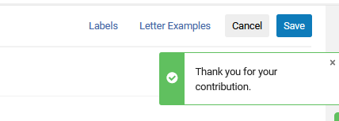
The XSL Editor
The contribution has been made

Slide 34
The XSL Editor
We can view and potentially copy other contributions of XSL versions

Slide 35
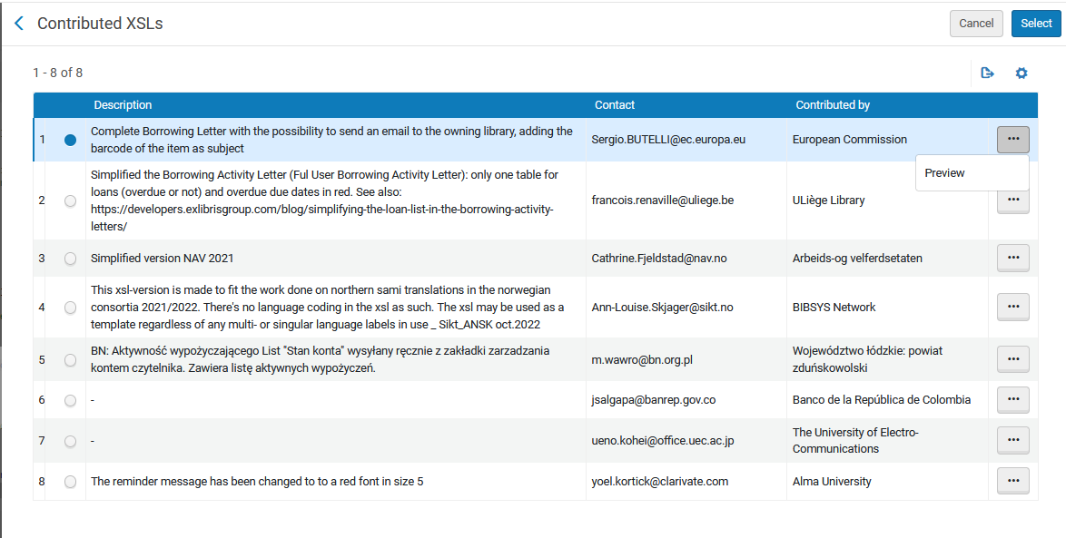
The XSL Editor
We can select an XSL to copy to our institution
We can preview an XSL before copying to our institution
This is the one we contributed a moment ago

Slide 36
Collapsing Sections, Indentation and Auto Complete

Slide 37
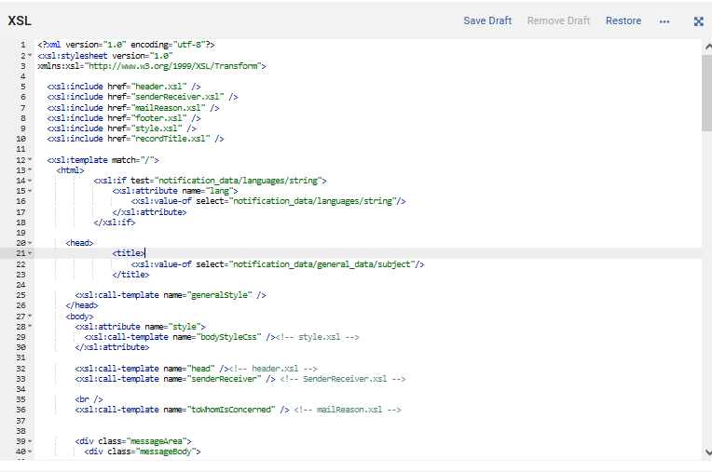
Collapsing Sections, Indentation and Auto Complete
In both the XSL editor and the XML editor there are "folding arrows" which can collapse an entire section

Slide 38
Collapsing Sections, Indentation and Auto Complete
For example, if we click the folding arrow on line 20 it will collapse the entire "head" section on lines 20 to 26

Slide 39
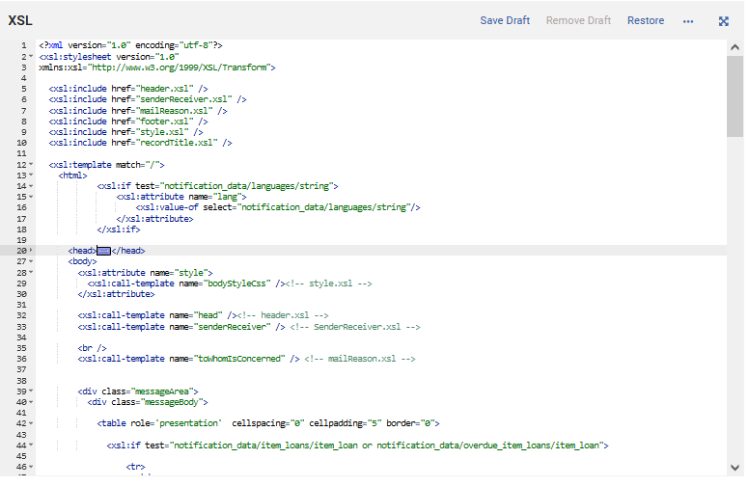
Collapsing Sections, Indentation and Auto Complete
Now the entire "head" section is collapsed

Slide 40
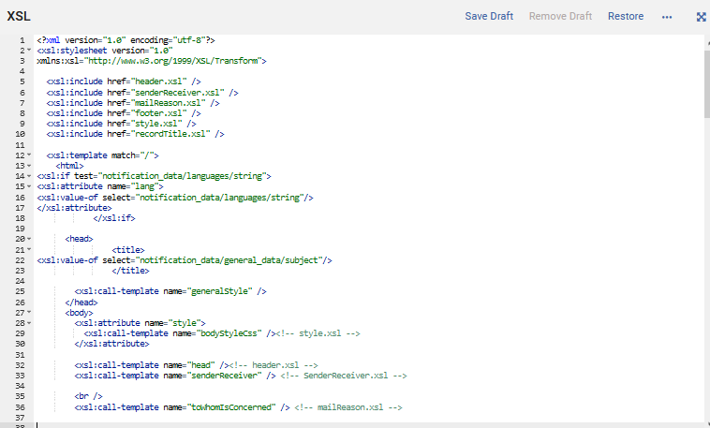
Collapsing Sections, Indentation and Auto Complete
It is also possible to use CTRL+SHIFT+F to fix indentation in both the XSL editor and XML editor.
We now have this and do CTRL+SHIFT+F

Slide 41
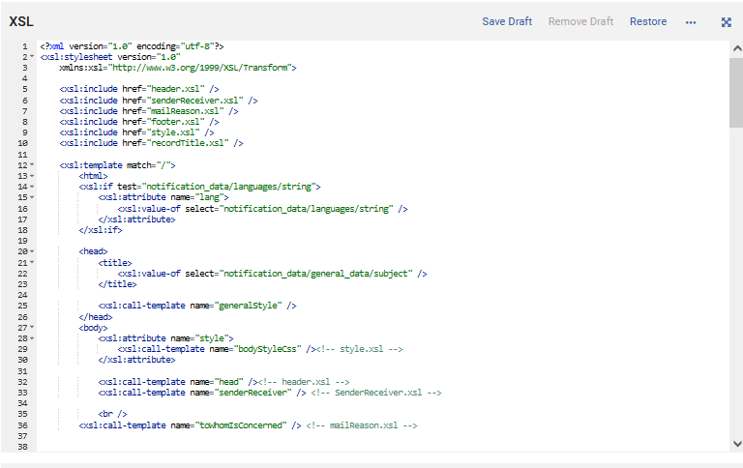
Collapsing Sections, Indentation and Auto Complete
The indentation has been fixed
We now have this

Slide 42
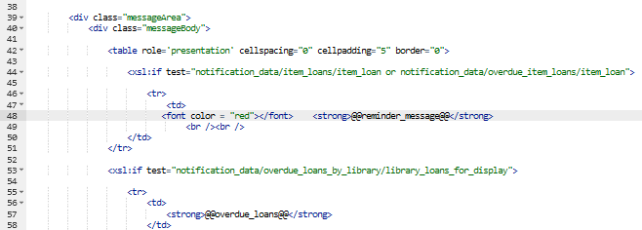
Collapsing Sections, Indentation and Auto Complete
The XSL and XML editor also have auto-complete for tags.
For example, if in XSL the user types '<center>' it adds '</center>' ?
Staff user typed <font color="red" size="5">
The closing tag </font> was automatically added

Slide 43
The XML Editor

Slide 44
The XML Editor
The XML determines the data of the letter.
The XML is based on an actual letter already sent to a user.
For example, in the case of the borrowing activity letter it will include the name and address of the patron and the items which are on loan to the user.
When the user edits the XML the Preview pane is updated according to the changes in the XML.
This is the case even before saving the XML.
This allows users to see what the changes would look like in a letter without yet saving the changes.

Slide 45
The XML Editor
The XML Editor

Slide 46
The XML Editor
After editing the XML users may
  Save the changes
  Restore the XML to its original state (the default version of the XML)
Additionally, users may
  View the XML in full screen mode

Slide 47
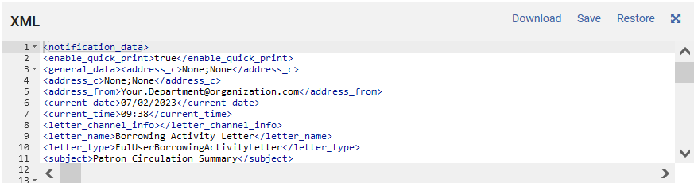
The XML Editor
Restore the XML to its original state
Edit the XML here
Download the XML to the PC
Save changes made to the XML

Slide 48
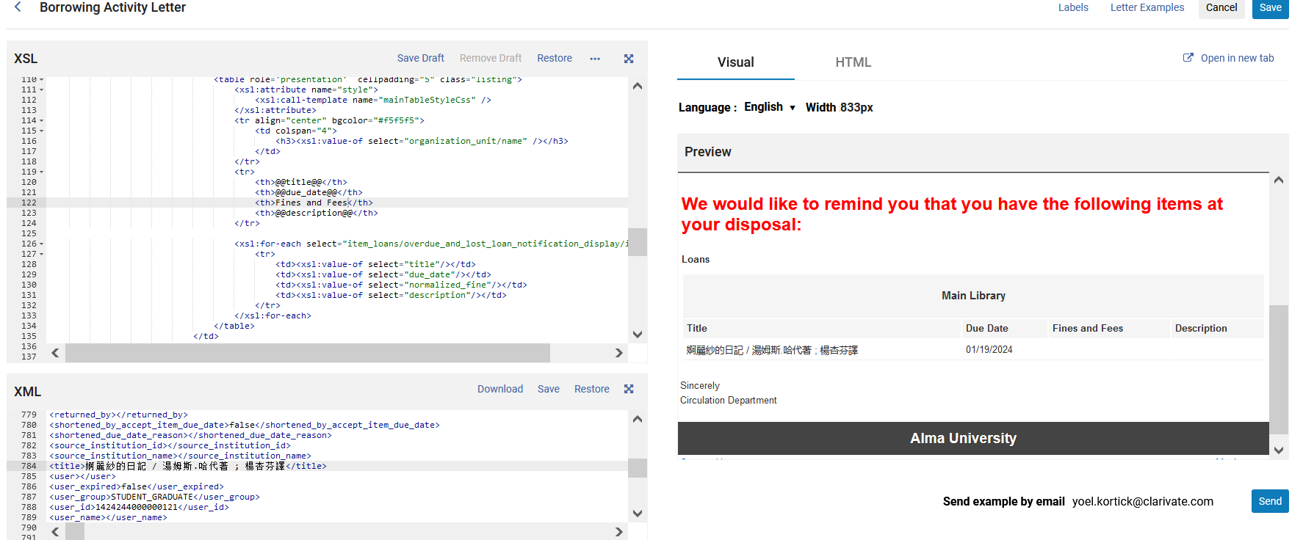
The XML Editor
We will now edit the title of the item on loan in the XML. We will change the language to check how it will appear in the letter, and be able to see the change immediately before saving the letter

Slide 49
The XML Editor
As an example, we will change this
<shortened_due_date_reason></shortened_due_date_reason>
<source_institution_id></source_institution_id>
<source_institution_name></source_institution_name>
<title>婀麗紗的日記 / 湯姆斯.哈代著 ; 楊杏芬譯</title>
<user></user>
<user_expired>false</user_expired>
<user_group>STUDENT_GRADUATE</user_group>
To this
<shortened_due_date_reason></shortened_due_date_reason>
<source_institution_id></source_institution_id>
<source_institution_name></source_institution_name>
<title>מבוא לספרנות</title>
<user></user>
<user_expired>false</user_expired>
<user_group>STUDENT_GRADUATE</user_group>

Slide 50
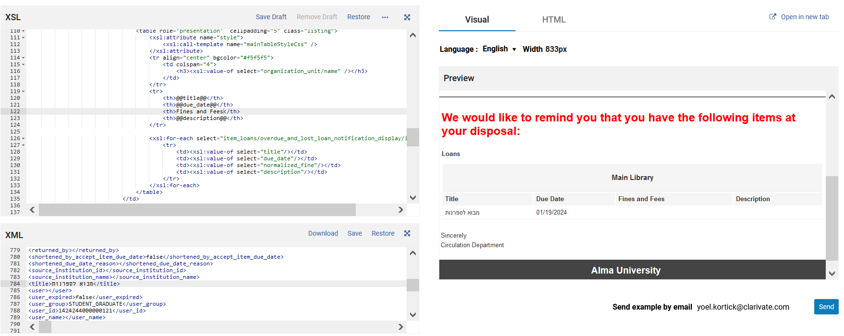
The XML Editor
We changed the XML here
We immediately see the change in the preview here

Slide 51
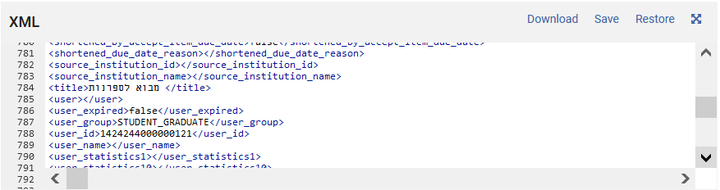
The XML Editor
We can save the changes

Slide 52
The XML Editor
Note that when editing the XML, if the user makes a mistake, then Alma will not only state that there is an error but also state what it is and where it is.
Here for example the staff user editing the XML by accident deleted the opening "<" in "</title>"
This
<title>מבוא לספרנות</title>
Was erroneously changed to this:
<title>מבוא לספרנות/title>
Missing the "<"

Slide 53
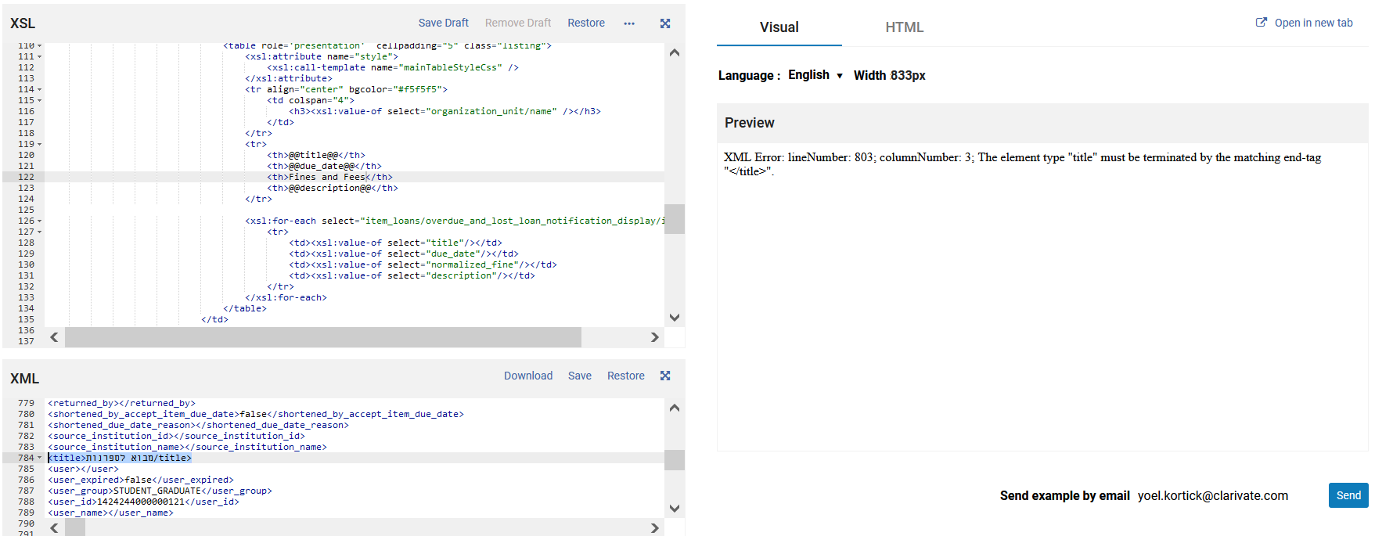
The XML Editor
Alma states what the error is and exactly where it is.

Slide 54
The XML Editor
The XML which appears in the XML editor is the default XML.
The default XML is determined by editing a specific letter and then clicking "Letter Examples" on the top right.
It is recommended to use previously-sent letters as the default XML.

Slide 55
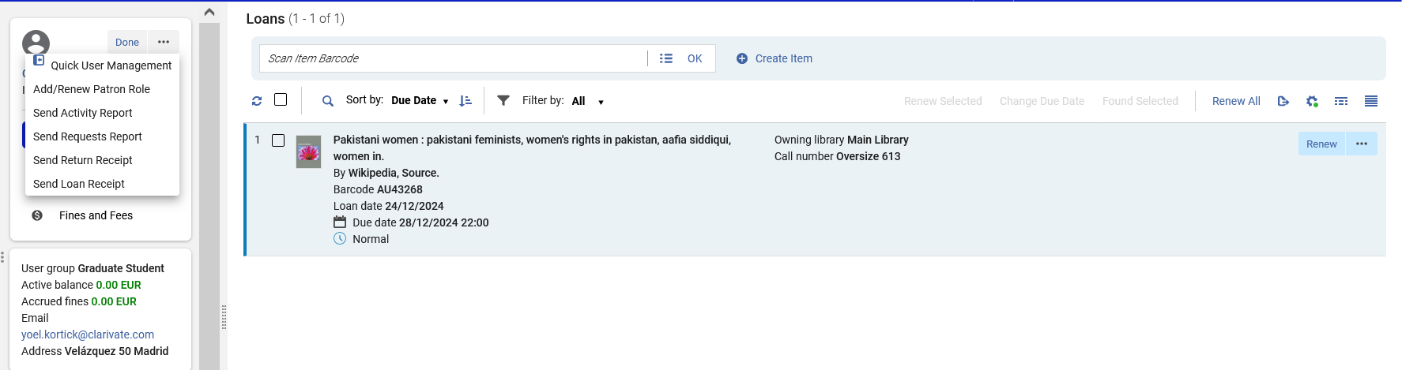
The XML Editor
For example, here we will send the borrowing activity letter to patron Caroline Devue.
Title: "Pakistani women : pakistani feminists, women's rights in Pakistan".
(We are pointing out the title to know that we will be viewing the letter for this loan in the future slides)

Slide 56
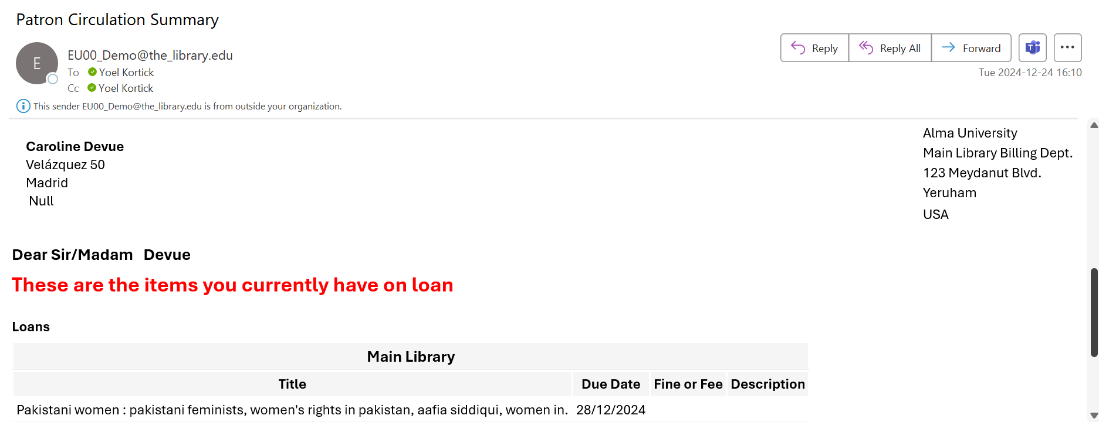
The XML Editor
The letter was sent
Title: "Pakistani women : pakistani feminists, women's rights in Pakistan"

Slide 57
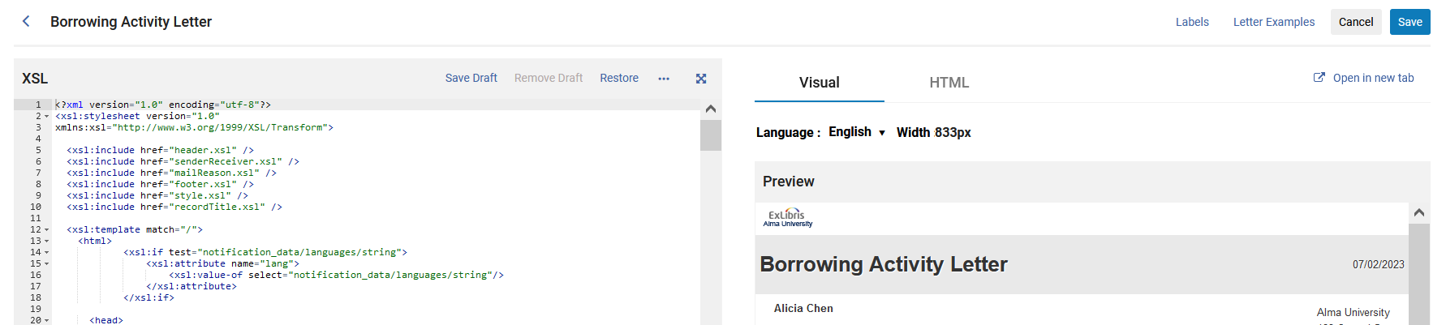
The XML Editor
Now we will make the XML of the letter which was just sent be the default XML
We will click "Letter Examples"

Slide 58
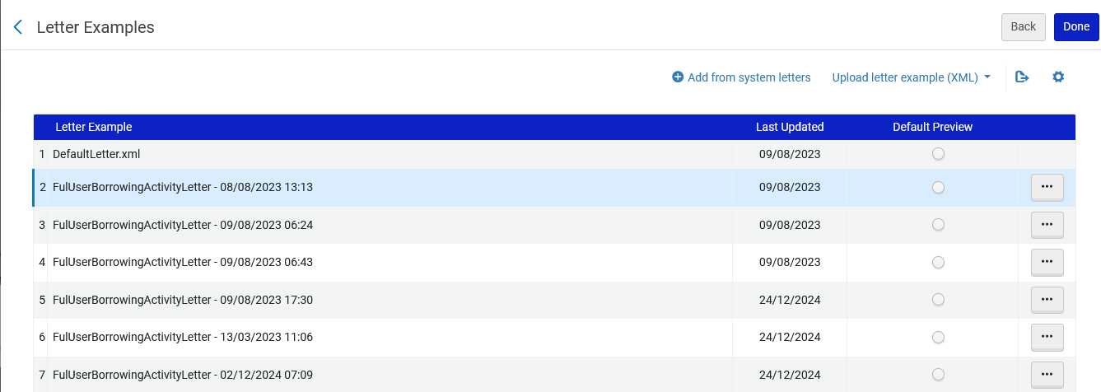
The XML Editor
Now we can determine the default XML
We will click "Add from system letters" to choose the XML of a previously-sent letter.
We will click "Add from system letters" to choose the XML of a previously-sent letter.
From here we could upload an XML from the PC

Slide 59
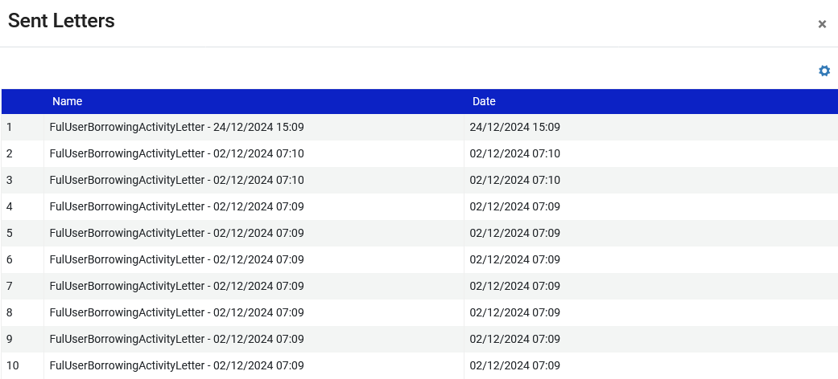
The XML Editor
This is what we see after clicking "Add from system letters"
This is the most recently-sent letter. We will click it to select it

Slide 60
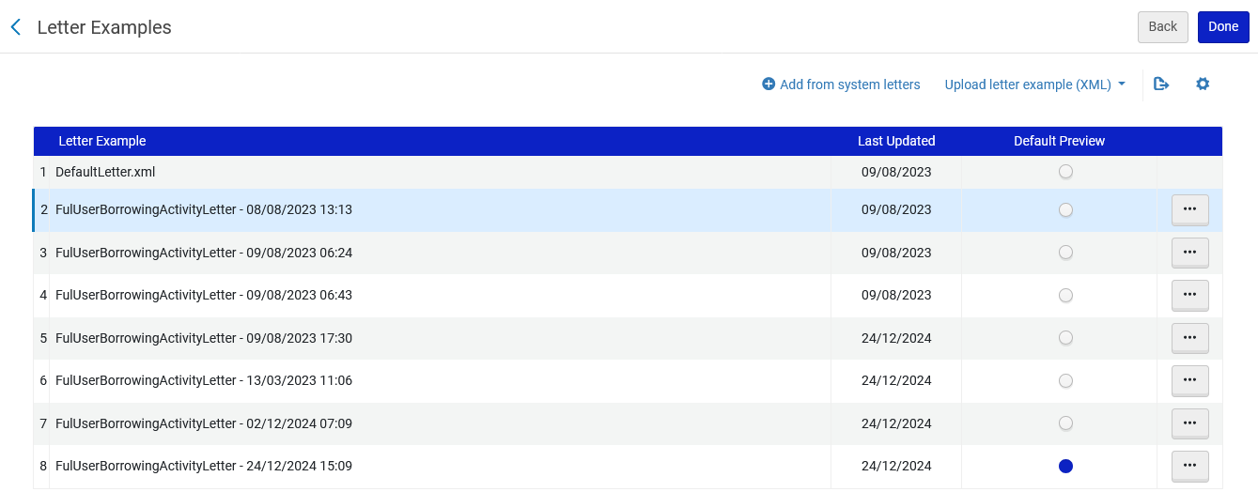
The XML Editor
It now appears in the "Letter Examples" and we have made it the default XML
We have made it the default XML
It now appears in the "Letter Examples"

Slide 61
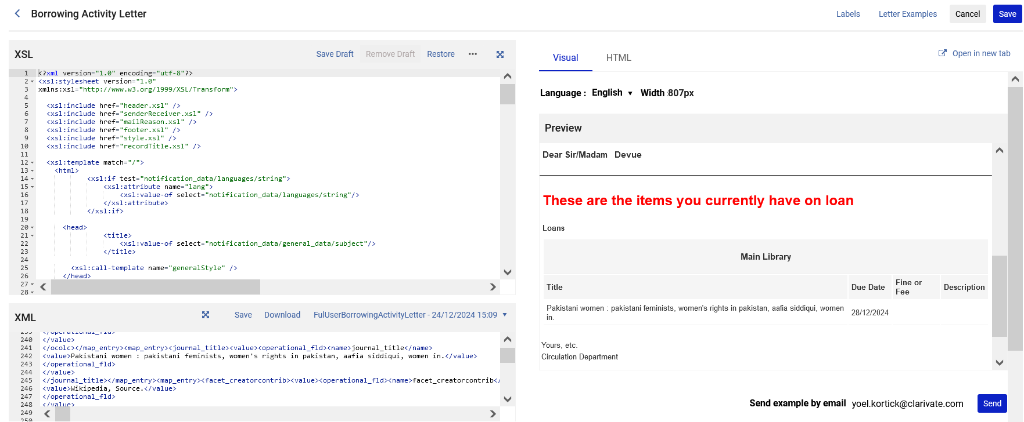
The XML Editor
We have made it the default XML
Title: "Pakistani women : pakistani feminists, women's rights in Pakistan"

Slide 62
Labels

Slide 63
Labels
At the beginning of this presentation, we stated as follows:
  The ultimate goal of authority control is not merely to engage in an academic exercise, but rather to ultimately aid the end user in finding desired material.
One significant way of aiding the end user in discovery and the staff user in Alma is to allow the "searcher" to search by the preferred term or by the non preferred term.

Slide 64
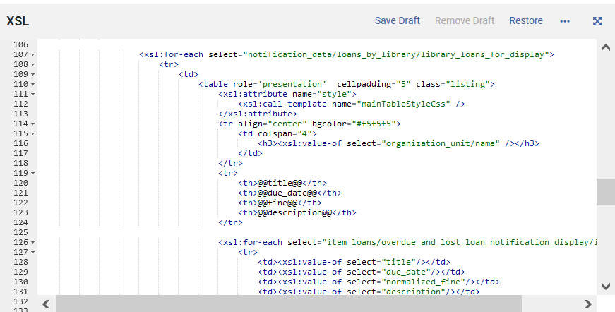
Labels
This will use label "title"
This will use label "due_date"
This will use label "fine"
This will use label "description"

Slide 65
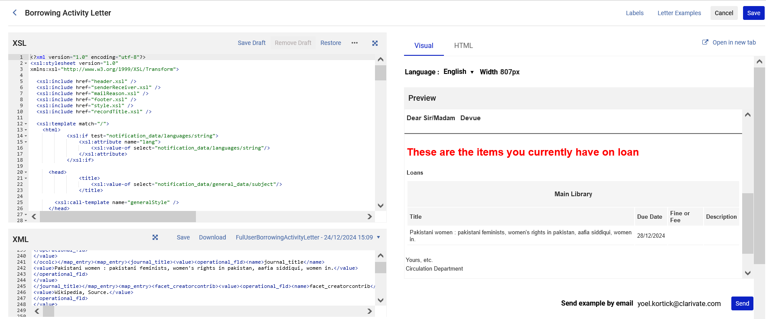
Labels
The labels are accessed by editing a specific letter and then clicking "Labels" on the top right.

Slide 66
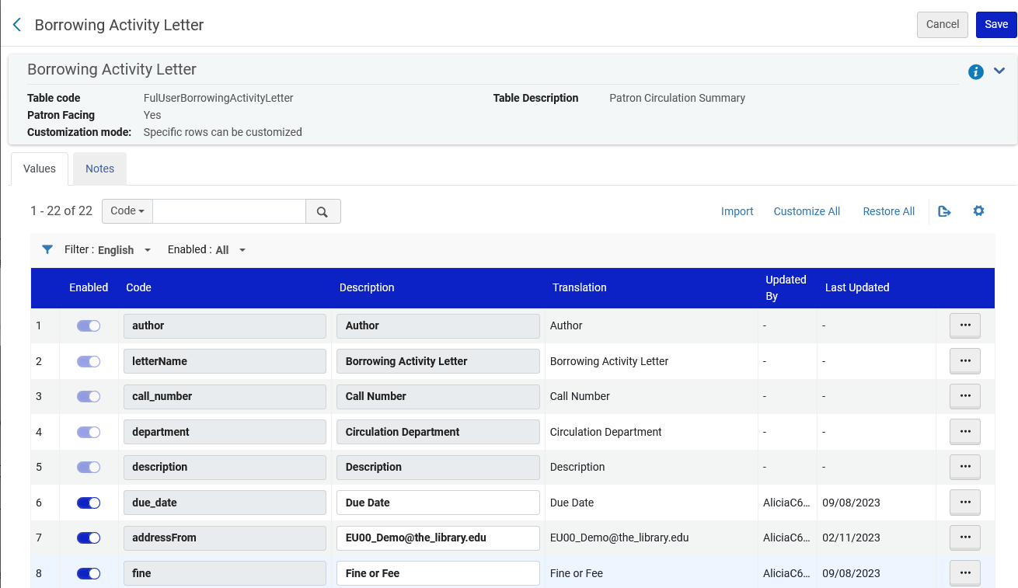
Labels
This is a partial screenshot of the labels for the "Borrowing Activity Letter"

Slide 67
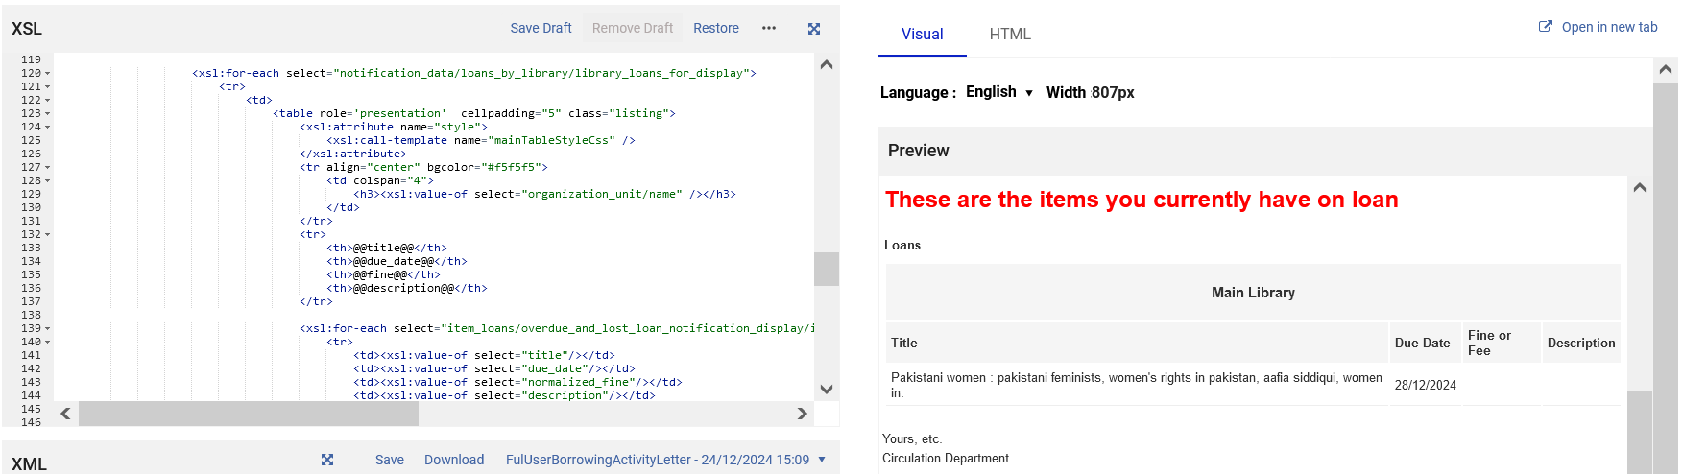
Labels
We will now change the labels "title" and "due_date" and "fine".
We will leave the label "description" as it is.

Slide 68
Labels
Customize the label "title"
Call it "Title of item"

Slide 69
Labels
Customize the label "due date"
Call it "Return on"

Slide 70
Labels
Customize the label "fine"
Call it "Fines and Fees"

Slide 71
Labels
We will leave the label "description" as it is

Slide 72
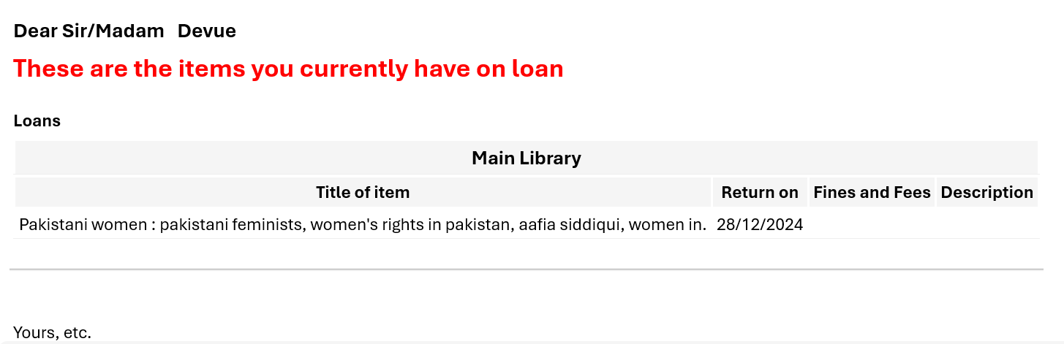
Labels
Now the text of the letter has changed

Slide 73
Drafts for letters in the XSL Editor

Slide 74
Drafts for letters in the XSL Editor
Working with drafts is useful when the staff user is working on a letter, has made some changes, but the changes are not finished, and the user does not want them to be the active (in use) XSL.
The staff user can save his or her changes as a draft and then come back to work on it later.
At the later time, the draft can be
  Saved as the active (in use) XSL
  Removed

Slide 75
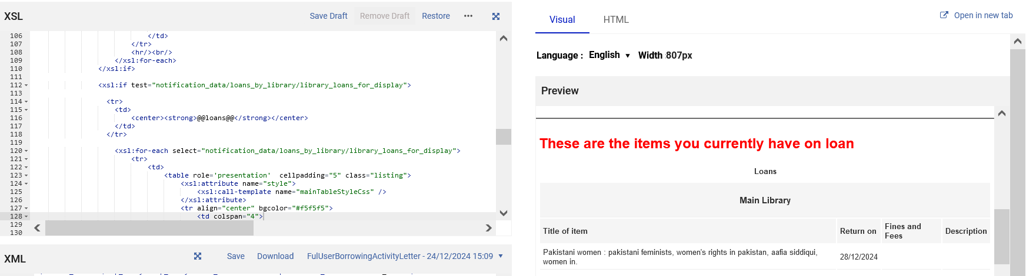
Drafts for letters in the XSL Editor
We will click "Save Draft" to save this as a draft
For example …
We have changed the label "loans" to be centered

Slide 76
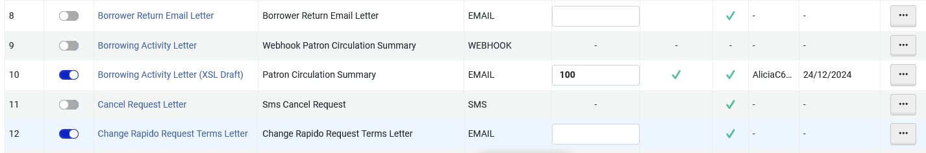
Drafts for letters in the XSL Editor
When a letter is saved as a draft there is a clear indication of such in the list of letters at "Letters Configuration"
We will now edit the "Borrowing Activity letter" which is a draft

Slide 77
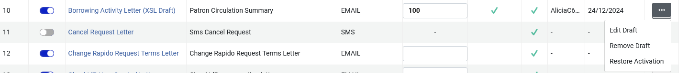
Drafts for letters in the XSL Editor
From the list of letters at "Letters Configuration" it is possible to "Remove Draft" and "Edit Draft"
We will "Edit Draft"
We will now edit the "Borrowing Activity letter" which is a draft

Slide 78
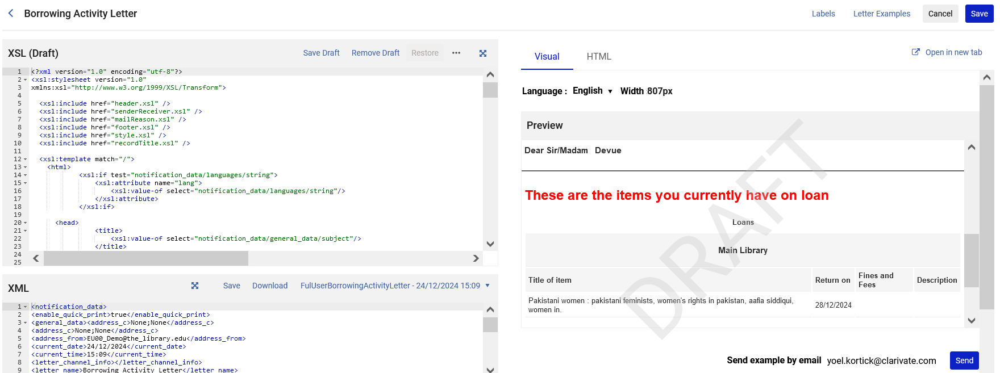
Drafts for letters in the XSL Editor
For example …
Now "Remove Draft" has become active (previously it was greyed out)
The preview has a clear indication that this is a draft

Slide 79
Drafts for letters in the XSL Editor
For example …
To save the draft as the active (in use) XSL click "Save"

Slide 80
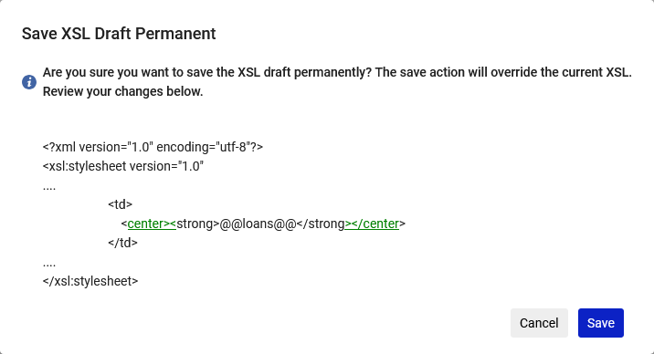
Drafts for letters in the XSL Editor
We clicked "Save" from the draft. We are notified of the change which has been made.
Now we will click "Save" in the confirmation message pop-up

Slide 81
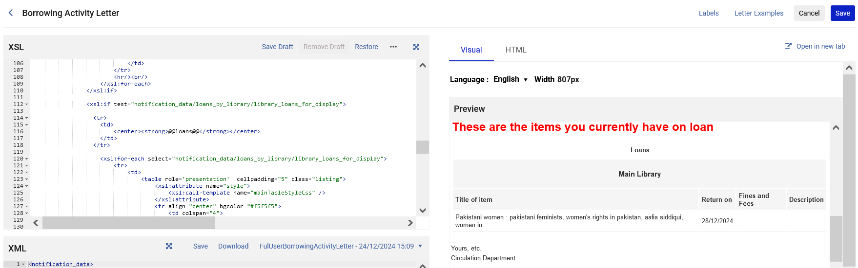
Drafts for letters in the XSL Editor
Now the active (in use) XSL has the changes that were originally made in the draft

Slide 82
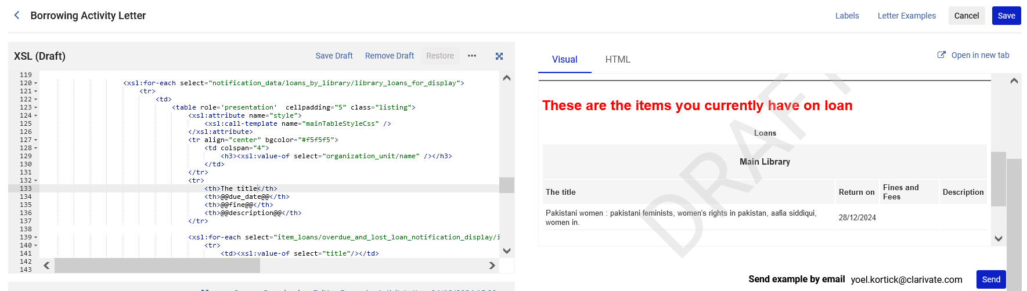
Drafts for letters in the XSL Editor
If the staff user made changes to the XSL, and did "Save Draft", and then decides that he or she does not want the draft, then he or she can click "Remove Draft"
We are looking at a draft and will click "Remove Draft"

Slide 83
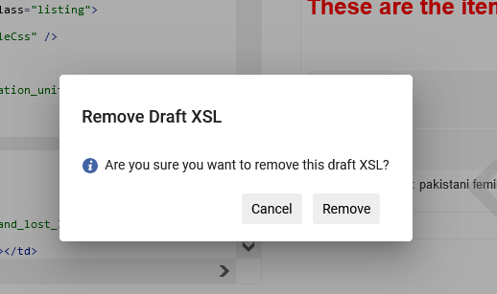
Drafts for letters in the XSL Editor
Now we will click "Remove" in the confirmation message pop-up

Slide 84

Drafts for letters in the XSL Editor
The draft has been removed
The text for "Remove Draft" is greyed out
There is no longer an indication that this is a draft

Slide 85
Components Configuration

Slide 86

Components Configuration
Many letters in Alma consist of "calls" to other letters.
For example, here is the beginning of the Borrowing Activity Letter

Slide 87
Components Configuration
These calls to common letters save the need to do repeated "coding" in each letter.
For example (almost) all letters start with the following (example on next slide)
  An icon
  Name of letter
  Date
By having the reference to these "common values" all in one referenced letter the design and configuration of the letter mechanism is efficient and easy to maintain.

Slide 88

Components Configuration
This is an example whereby (almost) all letters start with an icon, name of letter and date:
The reference to the logo, letter name and date is all in the one header.
It does not need to be in each separate xsl. Only a call to the header.xsl is needed.

Slide 89
Components Configuration
Here is the call to "header.xsl" in the Borrowing Activity Letter

Slide 90

Components Configuration
Logo
Letter name
Date

Slide 91
Components Configuration
The common XSL files are accessed via the "Components Configuration"

Slide 92

Components Configuration
For example, here the header can be changed, and it will immediately affect all letters that use the header

Slide 93

Components Configuration
Now we can change for example this …

Slide 94

Components Configuration
To this
We changed
<tr>
To
<tr align="right">

Slide 95
Components Configuration
And now instead of this (icon aligned left)

Slide 96

Components Configuration
We have this (icon aligned right)

Slide 97

Components Configuration
The change is also in effect for all other letters that "call" header.xsl
Both "Borrower Activity Letter" and "Analytics Letter" (as well as many other letters) use "header.xsl" so both were changed.

Slide 98
Drafts for components in the XSL Editor

Slide 99
Drafts for components in the XSL Editor
As we already saw, the components are accessed at "Configuration > General > Letters > Components Configuration"

Slide 100
Drafts for components in the XSL Editor
Staff Users can configure a component and then save the letter as a draft.
In this way it is possible to see how it will look in a letter without saving as the active (in use) XSL.
As we will soon see, there is a special method to "call" the draft component from within the XSL of the letters.

Slide 101

Drafts for components in the XSL Editor
Let's edit the component "footer.xsl"

Slide 102

Drafts for components in the XSL Editor
We will change this (we will make the "My Account" be centered instead of right justified)
<xsl:template name="myAccount">
<table align="right">
<tr>
<td align="right">
<a>
<xsl:attribute name="href">
@@email_my_account@@
</xsl:attribute>
@@my_account@@
</a>

Slide 103

Drafts for components in the XSL Editor
To this
<xsl:template name="myAccount">
<table align="center">
<tr>
<td align="center">
<a>
<xsl:attribute name="href">
@@email_my_account@@
</xsl:attribute>
@@my_account@@
</a>

Slide 104

Drafts for components in the XSL Editor
We will save it as a draft

Slide 105

Drafts for components in the XSL Editor
There is now a clear indication that it is a draft

Slide 106
Drafts for components in the XSL Editor
To use the component draft in a real letter:
Edit an XSL letter that uses the component (for example the Borrowing Activity Letter) and change the component name to include the suffix "_DRAFT"
  For example, instead of: <xsl:include href="footer.xsl" />
  It will be: <xsl:include href="footer.xsl_DRAFT" />
Adding the "_DRAFT" suffix will cause the letter preview to use the draft component
  In this manner the staff user can review the changes and decide whether to save the draft component as it is permanently
When changes are complete, the draft component can be saved (using the "Save" button instead of the "Save Draft" button)
The "_DRAFT" suffix can be removed from the letter XSL

Slide 107

Drafts for components in the XSL Editor
Let's now go call the footer.xsl which we saved as a draft.
We will call it from the borrowing activity letter

Slide 108

Drafts for components in the XSL Editor
<xsl:include href="footer.xsl" />
Using the "regular" footer
The "My Account" is right justified

Slide 109

Drafts for components in the XSL Editor
<xsl:include href="footer.xsl_DRAFT" />
Using the "draft" footer
The "My Account" is center justified

Slide 110

Drafts for components in the XSL Editor
A close-up of the XSL from the previous slide
The call to the draft component

Slide 111
Drafts for components in the XSL Editor
If the staff user is satisfied with the changes made in the draft, then the steps now would be:
Save the draft component using the "Save" button instead of the "Save Draft" button
Remove the "_DRAFT" suffix from the letter XSL for which the component was tested.

